Slide 1
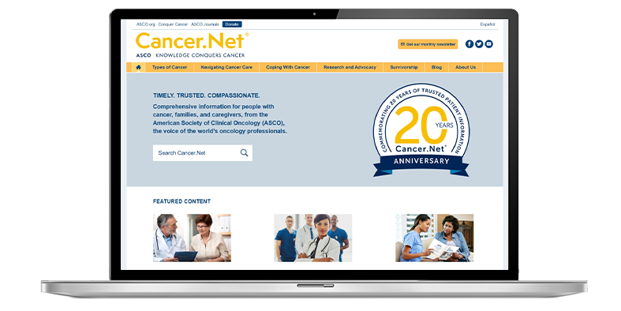
Timely, Trusted, and Compassionate
Patient Information from ASCO
Content approved by ASCO experts
Guides for 120+ cancer types and syndromes
Videos, podcasts, and blogs
Award-winning mobile app
Spanish language content
Patient education booklets and fact sheets
Visit www.cancer.net • Follow @CancerDotNet

